Slide 1
Objective: Build an application that collects news articles from various RSS feeds
By
Amresh Kumar

Slide 2
Agenda
Abstract
Introduction
Methods
Selected Methods
Implementation
Result and Discussion
Conclusion

Slide 3
Abstract
Categories the news item should fall under are:
Terrorism / protest / political unrest / riot
Positive/Uplifting
Natural Disasters
Others

Slide 4
Introduction
A dynamic News Categorization App designed to collect, store, and categorize news articles from various RSS feeds.
Using technologies like Feedparser, Celery, and NLP, the app classifies articles into predefined categories such as "Terrorism/Protest/Political Unrest/Riot," "Positive/Uplifting," "Natural Disasters," and "Others."
Join us as we explore its robust ETL pipeline, distributed task management, and seamless integration of machine learning models, ensuring efficient and reliable news classification.
This brief presentation offers a glimpse into our innovative solution, addressing the challenges of information overload in the digital age

Slide 5
What is Machine Learning?
Machine learning (ML) is the science of creating algorithms and statistical models that computers use to perform tasks without explicit instructions.
ML algorithms process large amounts of historical data and identify data patterns.

Slide 6
Steps Followed
Data Collection
Data Cleaning
Data Visualization
Dividing Data into Train And test
Model used By Hugging Face
Future Prediction
Deployment
Creating a data frame
Saving to CSV file

Slide 7
Data Collection
Utilized the feedparse library to extract the most recent data.
Created a separate data frame for each link.
Combined all the individual data frames into one comprehensive data frame.
Converted the aggregated data into a CSV file

Slide 8
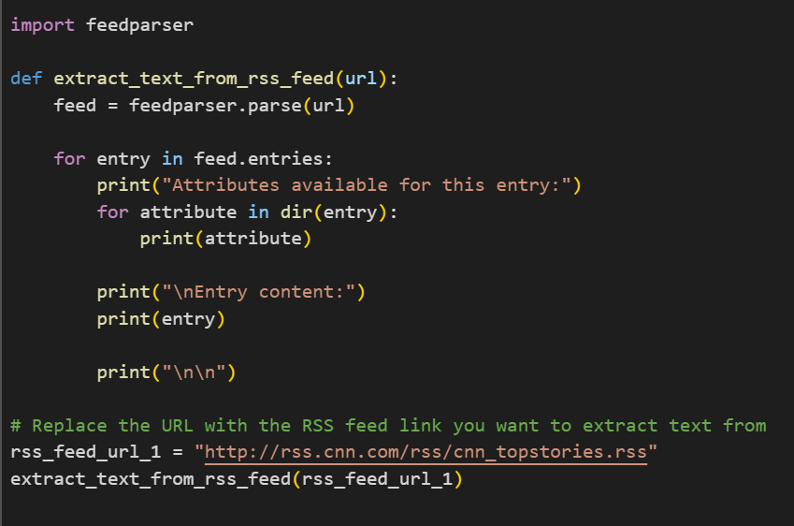
Data from Links
Importing Necessary Libraries to read the data.
Collecting data from different links

Slide 9
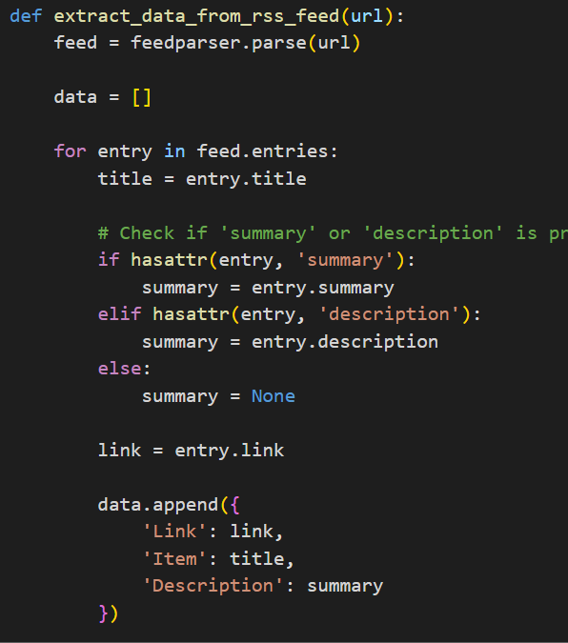
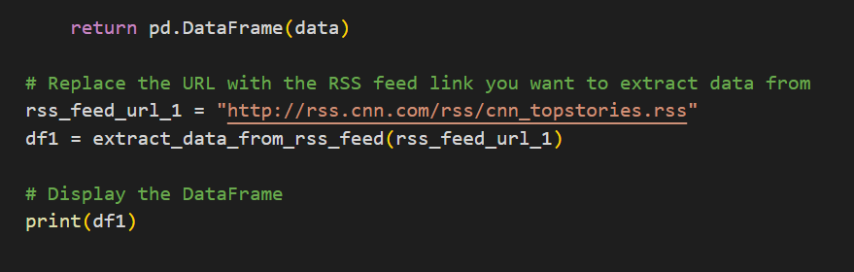
Creating a Data Frame
With the help of given code extracted data is converted into Data Frame.
Named every data frame as df1, df2, df3, df4, df5, and df6

Slide 10
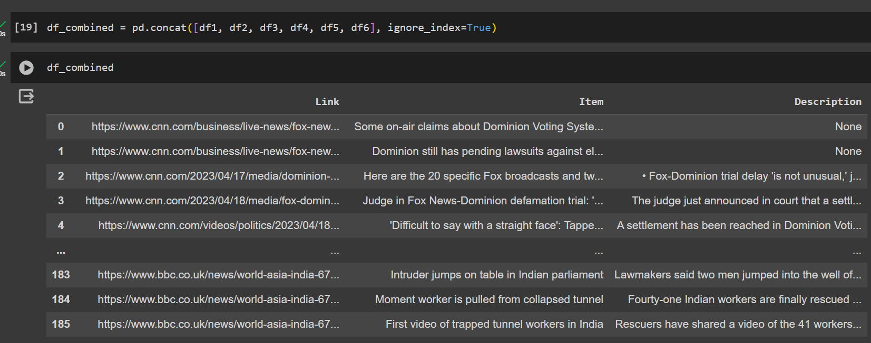
Combined All Data Frame

Slide 11
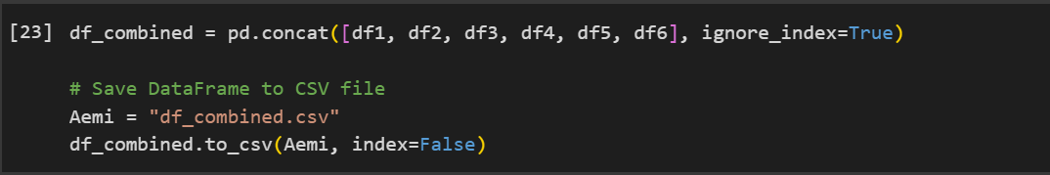
Saved as CSV file

Slide 12
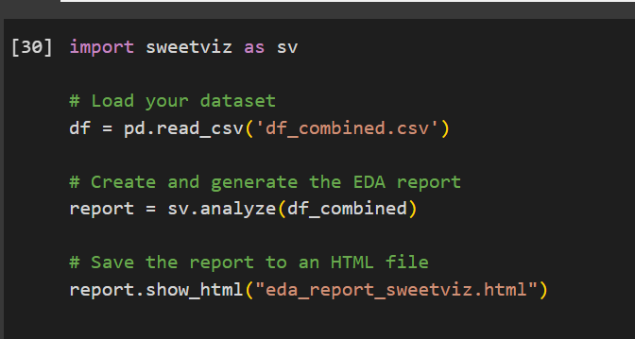
Auto EDA

Slide 13
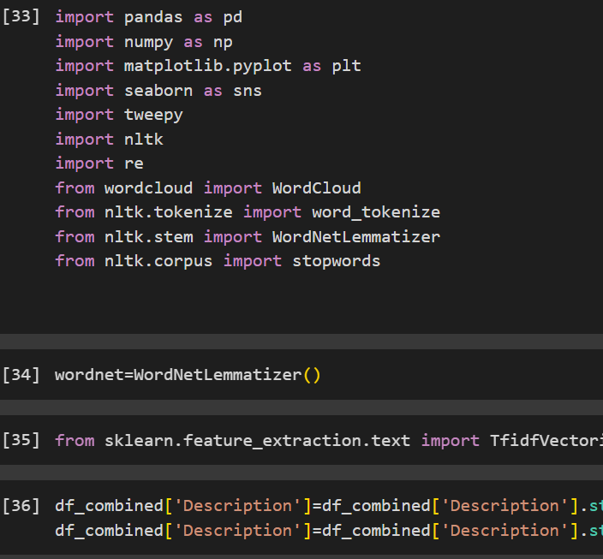
Feature Engineering
TFIDF Vectorizer
Converting into Lower Case
Removing Stop words.

Slide 14
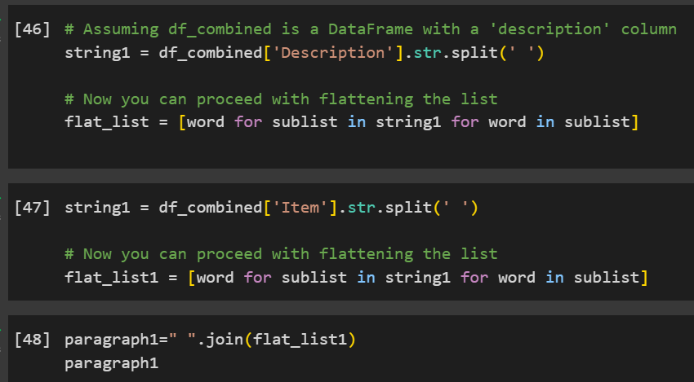
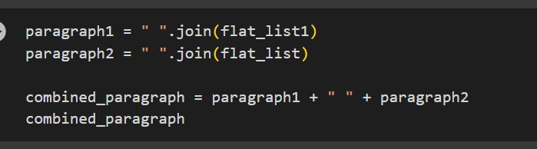
Combining Item and Description Columns

Slide 15
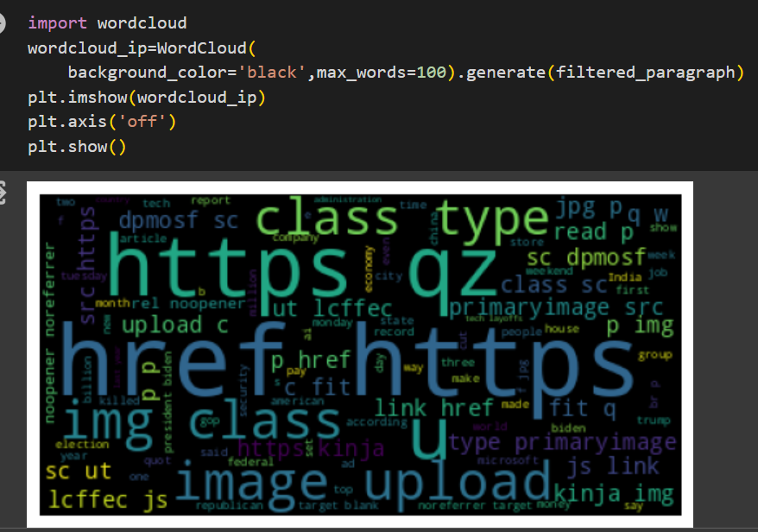
Word Cloud for Visualization

Slide 16
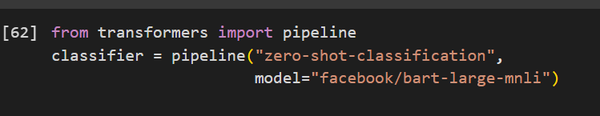
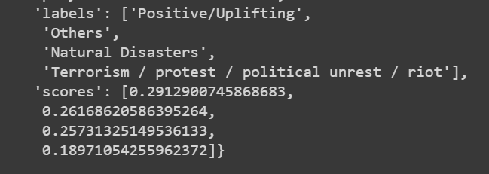
Created Pipeline and used Hugging Face model to check the score

Slide 17
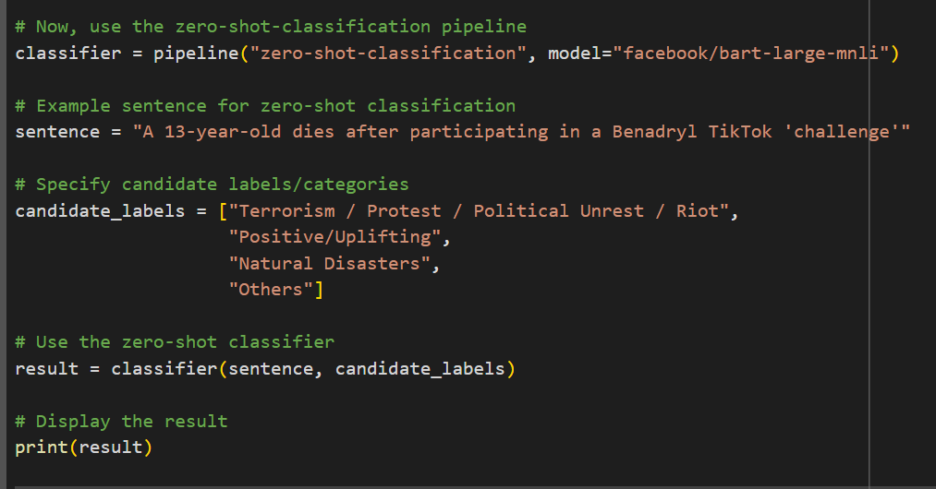
Build a model And predicted with new data

Slide 18
Deployment

Slide 19
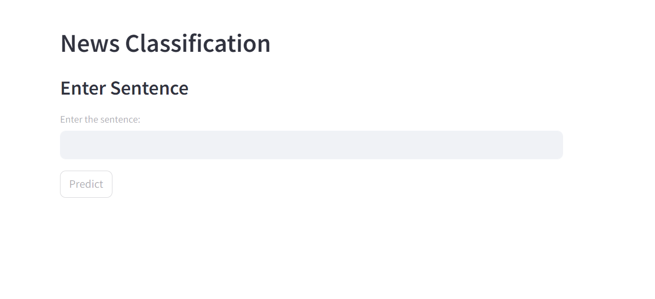
Interface created using streamlit

Slide 20
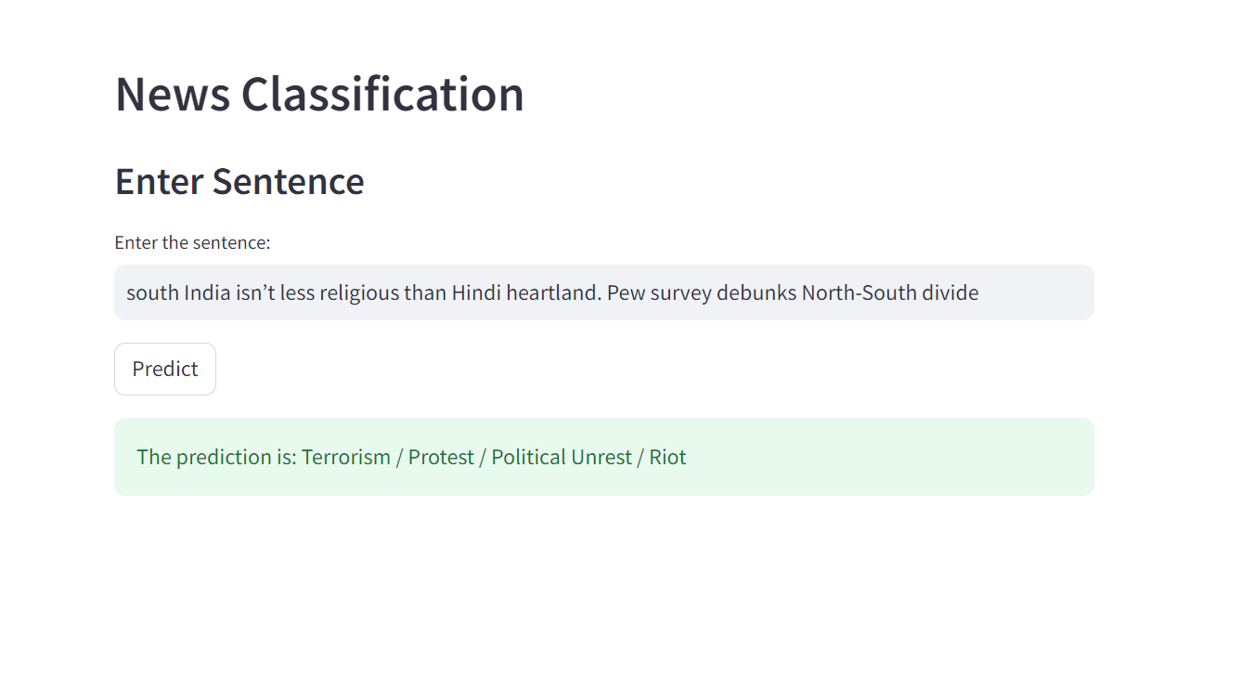
Prediction with new Data

Slide 21
BY
Amresh Kumar
Thankyou

